Slide 1
Physical Computing with
Device Simulator Express

Slide 2
01
What is Device Simulator Express (DSE)?
02
Devices Supported by DSE
T
I
T
L
E
03
Prerequisites
04
Integration of VSE to VS Code

Slide 3
What is Device Simulator Express
(DSE)?
It is a Microsoft Garage project, allows you to code microcontrollers without the hardware on hand!*
Test and debug your code on the device simulator and see the same result when you plug in your actual microcontroller.*
*https://marketplace.visualstudio.com/items?itemName=ms-python.devicesimulatorexpress

Slide 4
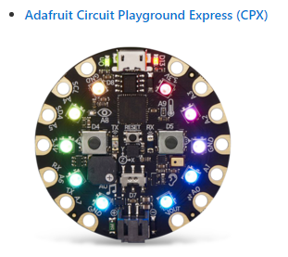
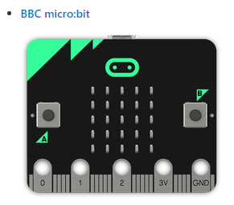
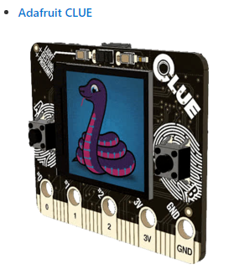
Devices Supported by DSE

Slide 5
Adafruit Circuit Playground Express
(CPX) Simulator
Included in the simulator
Green LED
Red LED
Push Buttons A and B
Slider Switch
Speaker: Play .wav file
10 NeoPixels
Light sensor
Motion sensors
Acceleration detection
Device shake detection
Temperature sensor
7 Capacitive Touch sensors

Slide 6
BBC micro:bit Simulator
Included in the simulator
25 LEDs
Push Buttons A and B
Light sensor
Motion sensors
Acceleration detection including gesture detection
Temperature sensor

Slide 7
Adafruit CLUE Simulator
Included in the simulator
25 LEDs
Push Buttons A and B
Light sensor
Motion sensors
Acceleration detection including gesture detection
Temperature sensor

Slide 8
Prerequisites
Visual Studio Code
Python 3.7+: Make sure you've added Python and pip to your PATH in your environment variables.
Python VS Code extension: This will be installed automatically from the marketplace when you install Device Simulator Express.

Slide 9
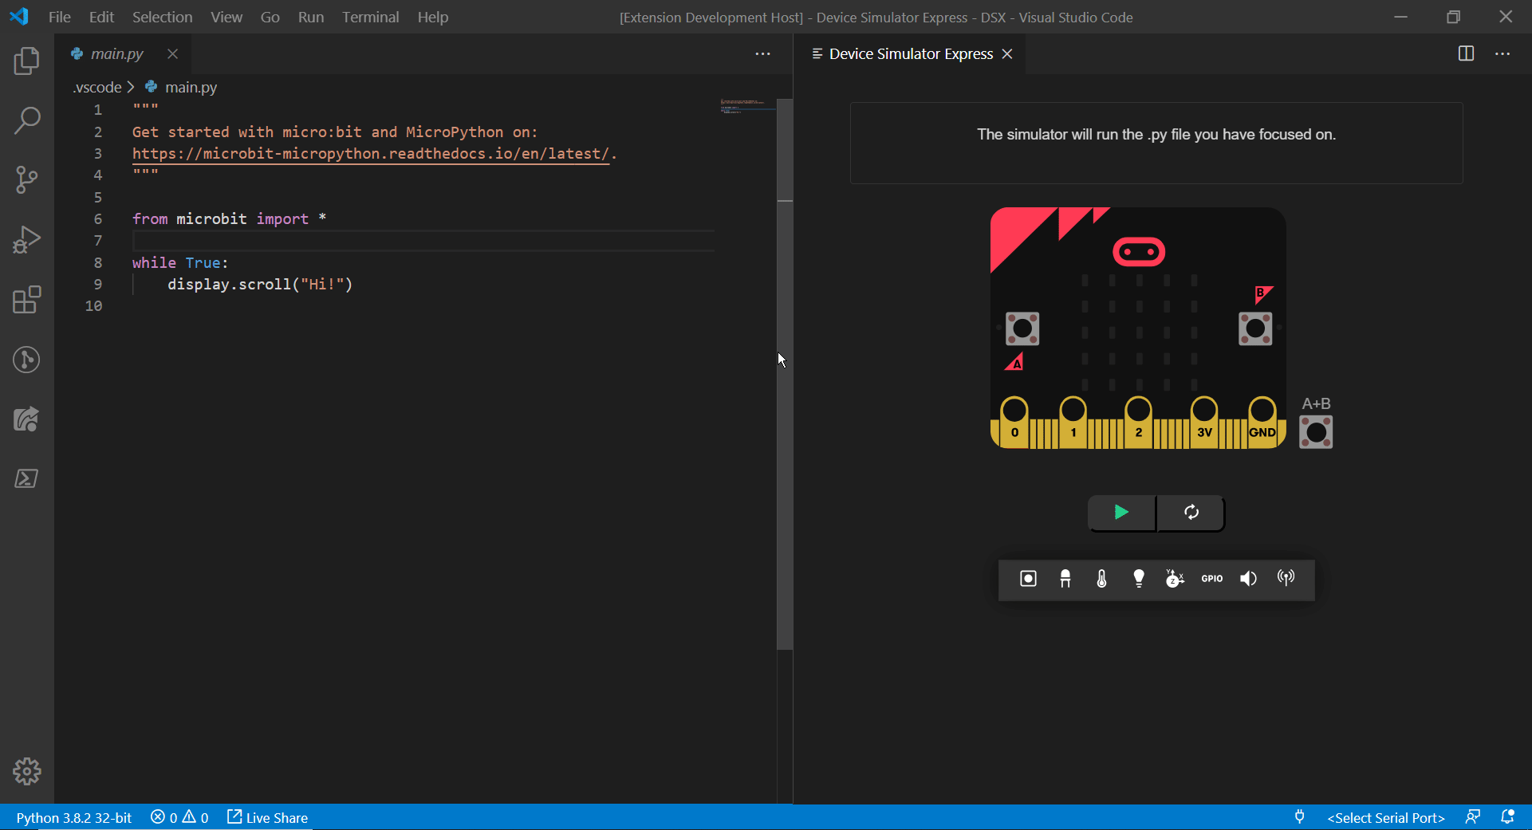
Integration of DSE to Visual Studio
Code

Slide 10





Thank you !
www.passerellesnumeriques.org

Slide 11














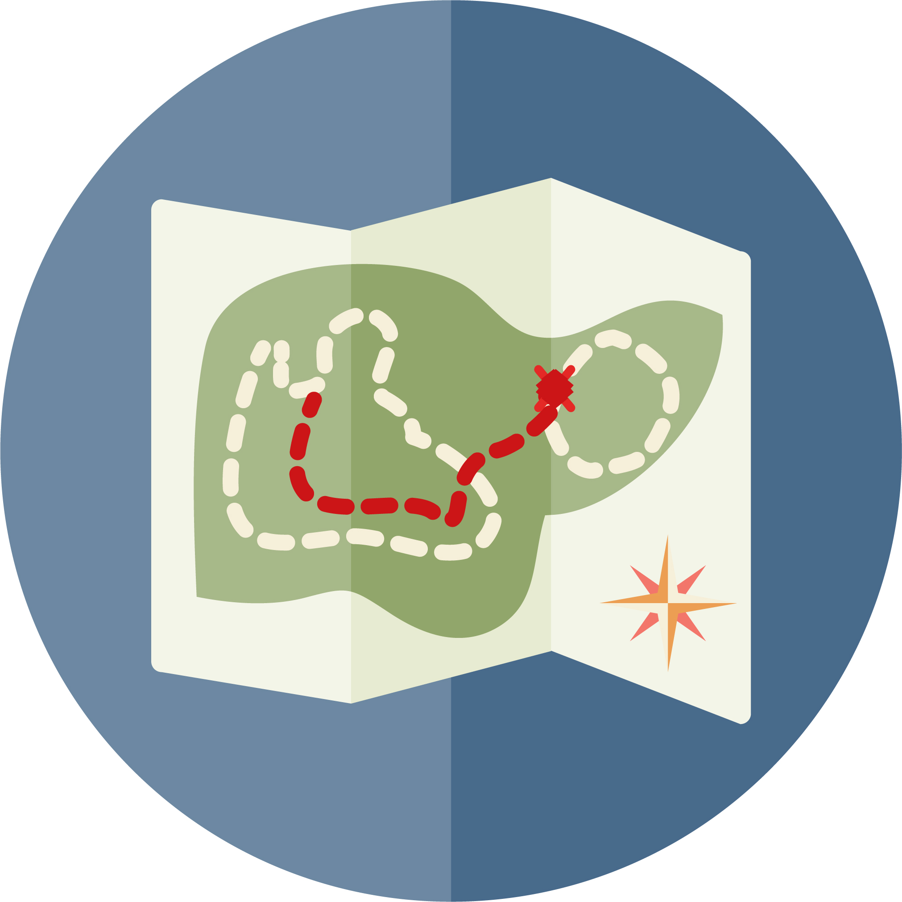







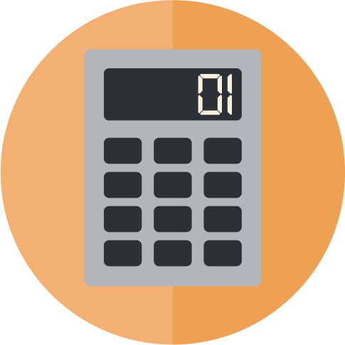


TOOL BOX - 1
Testimonial
General
Training
Employability
Palm Tree
Checkbox
Exclamation
Arrow
Technical
Training
Graduation
Employment
Idea
Time
Arrow
Arrow
Selection
Information
Job Search
Laptop
Email
LinkedIn
Facebook
Partnership
Education
Finance
Calendar
Twitter
Youtube
Website

Slide 12
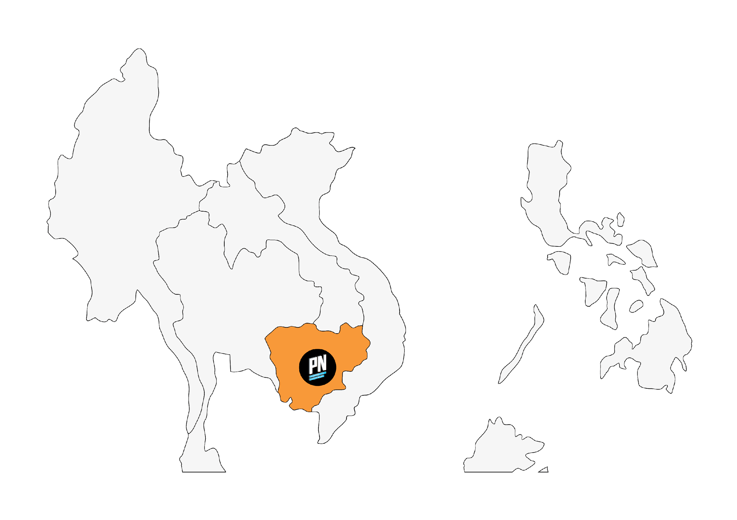

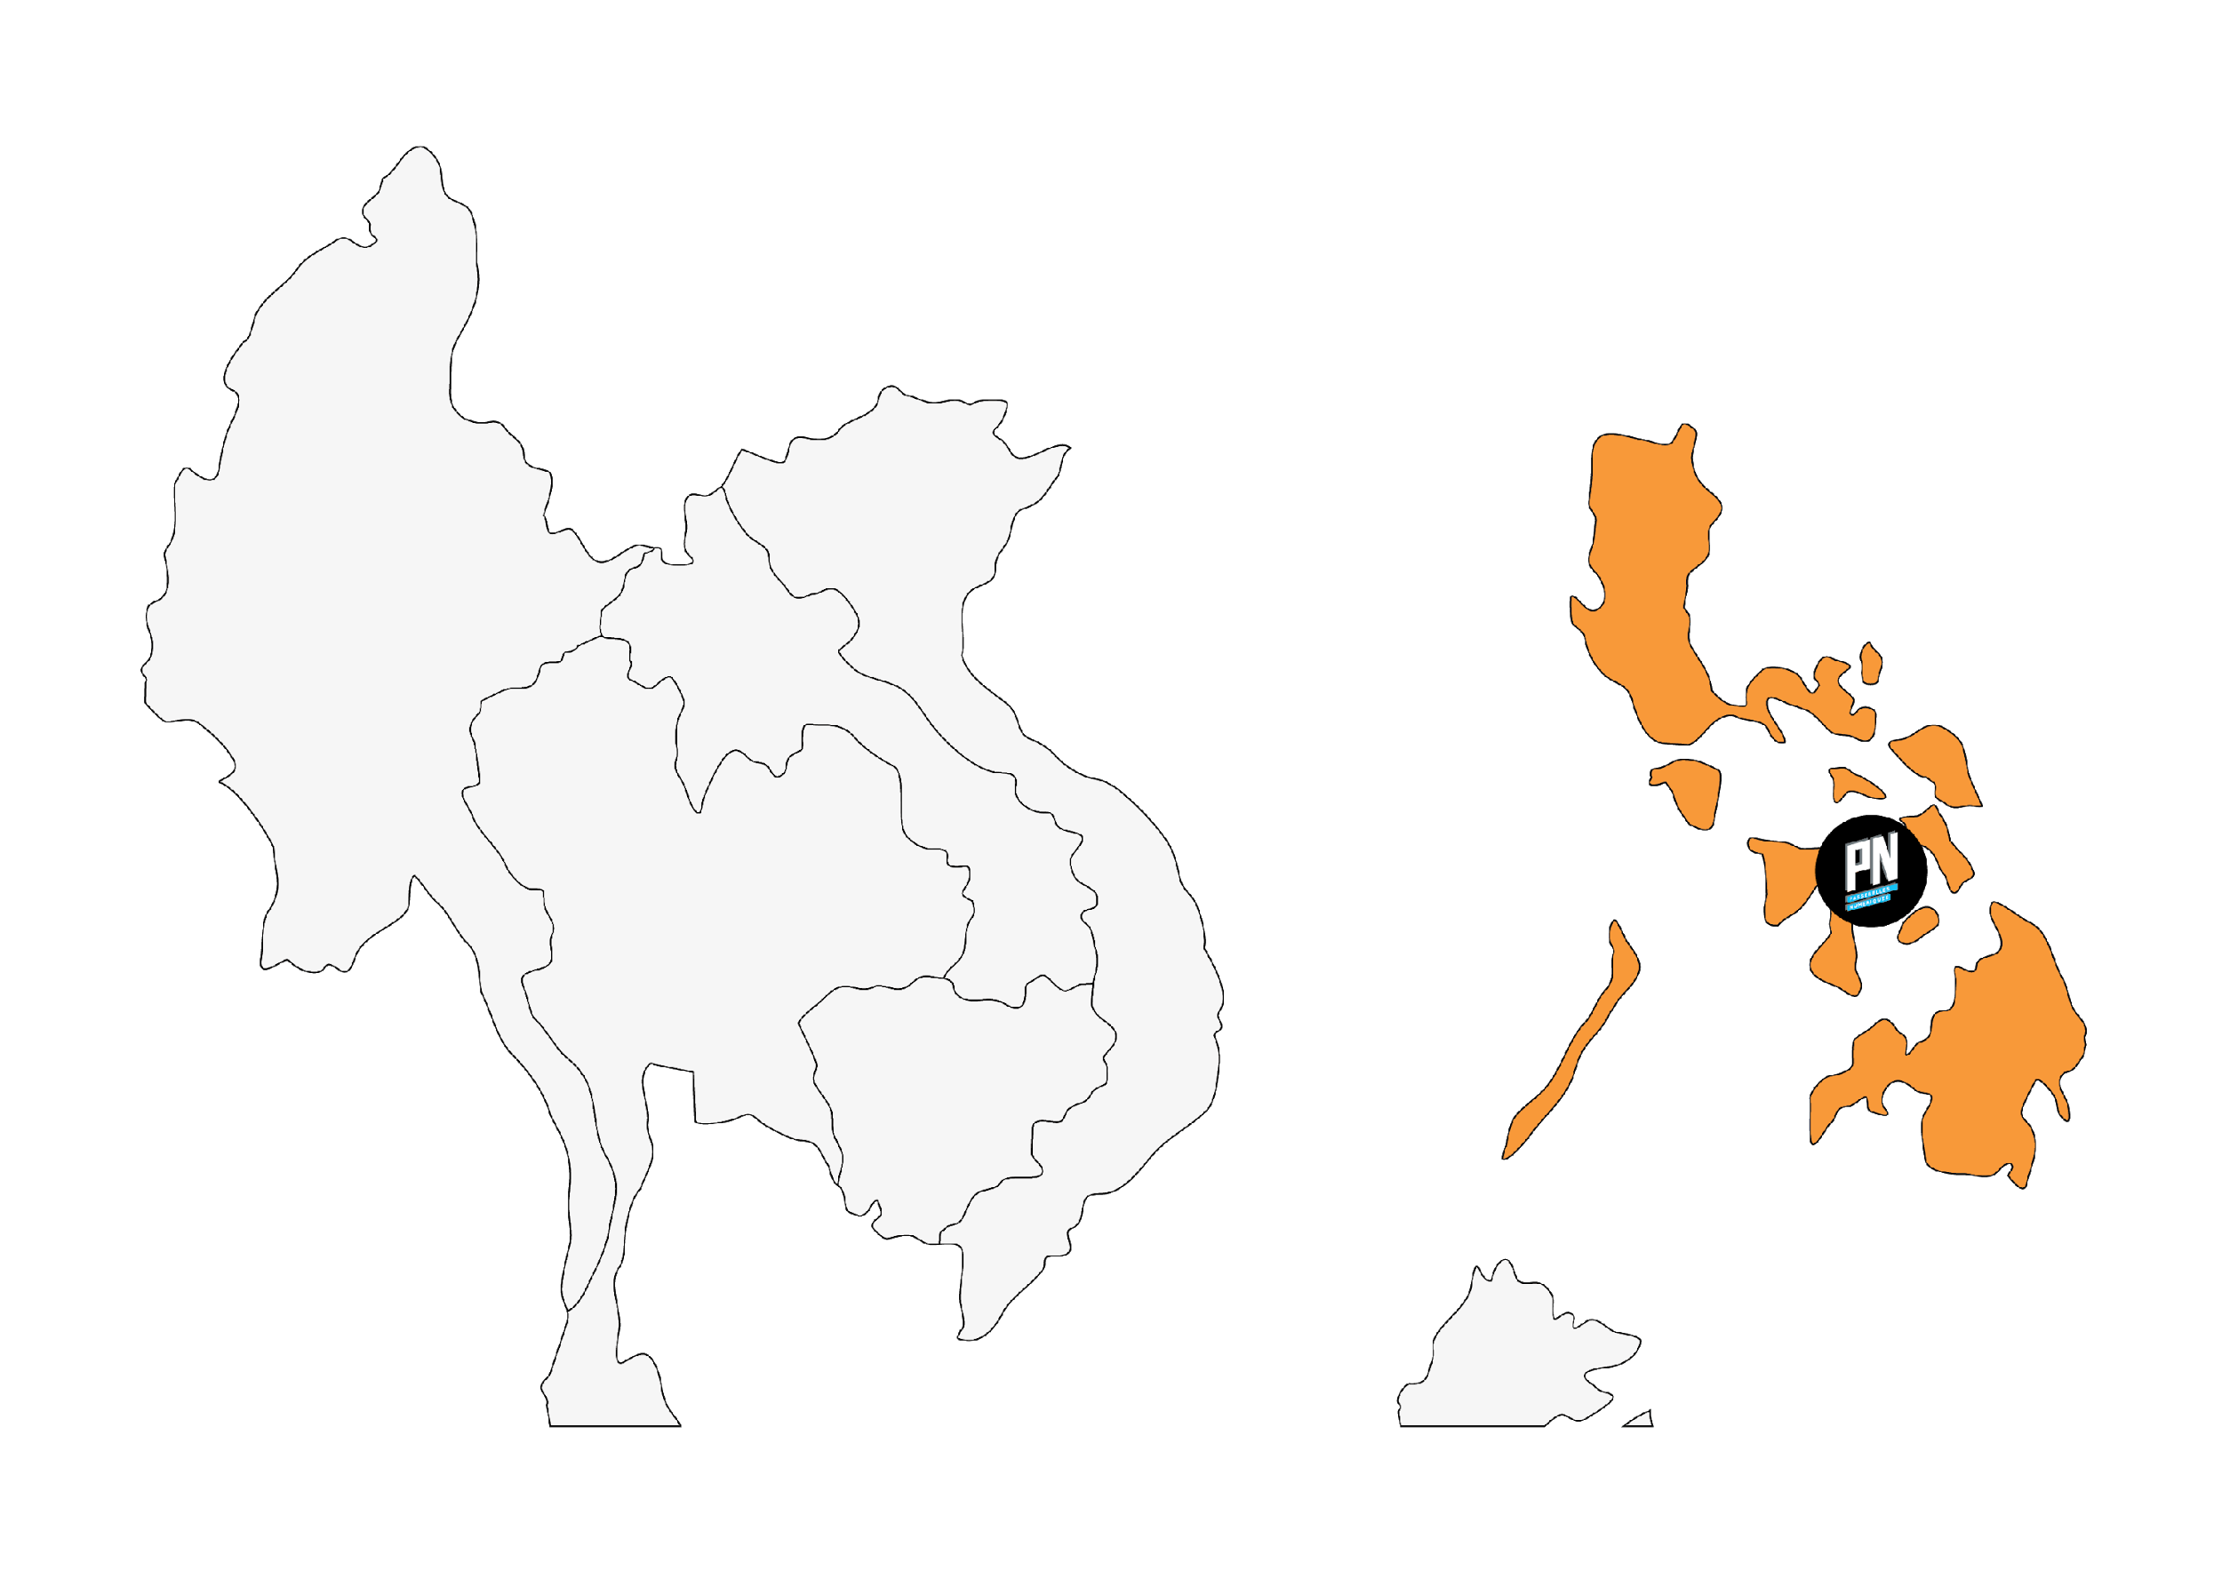





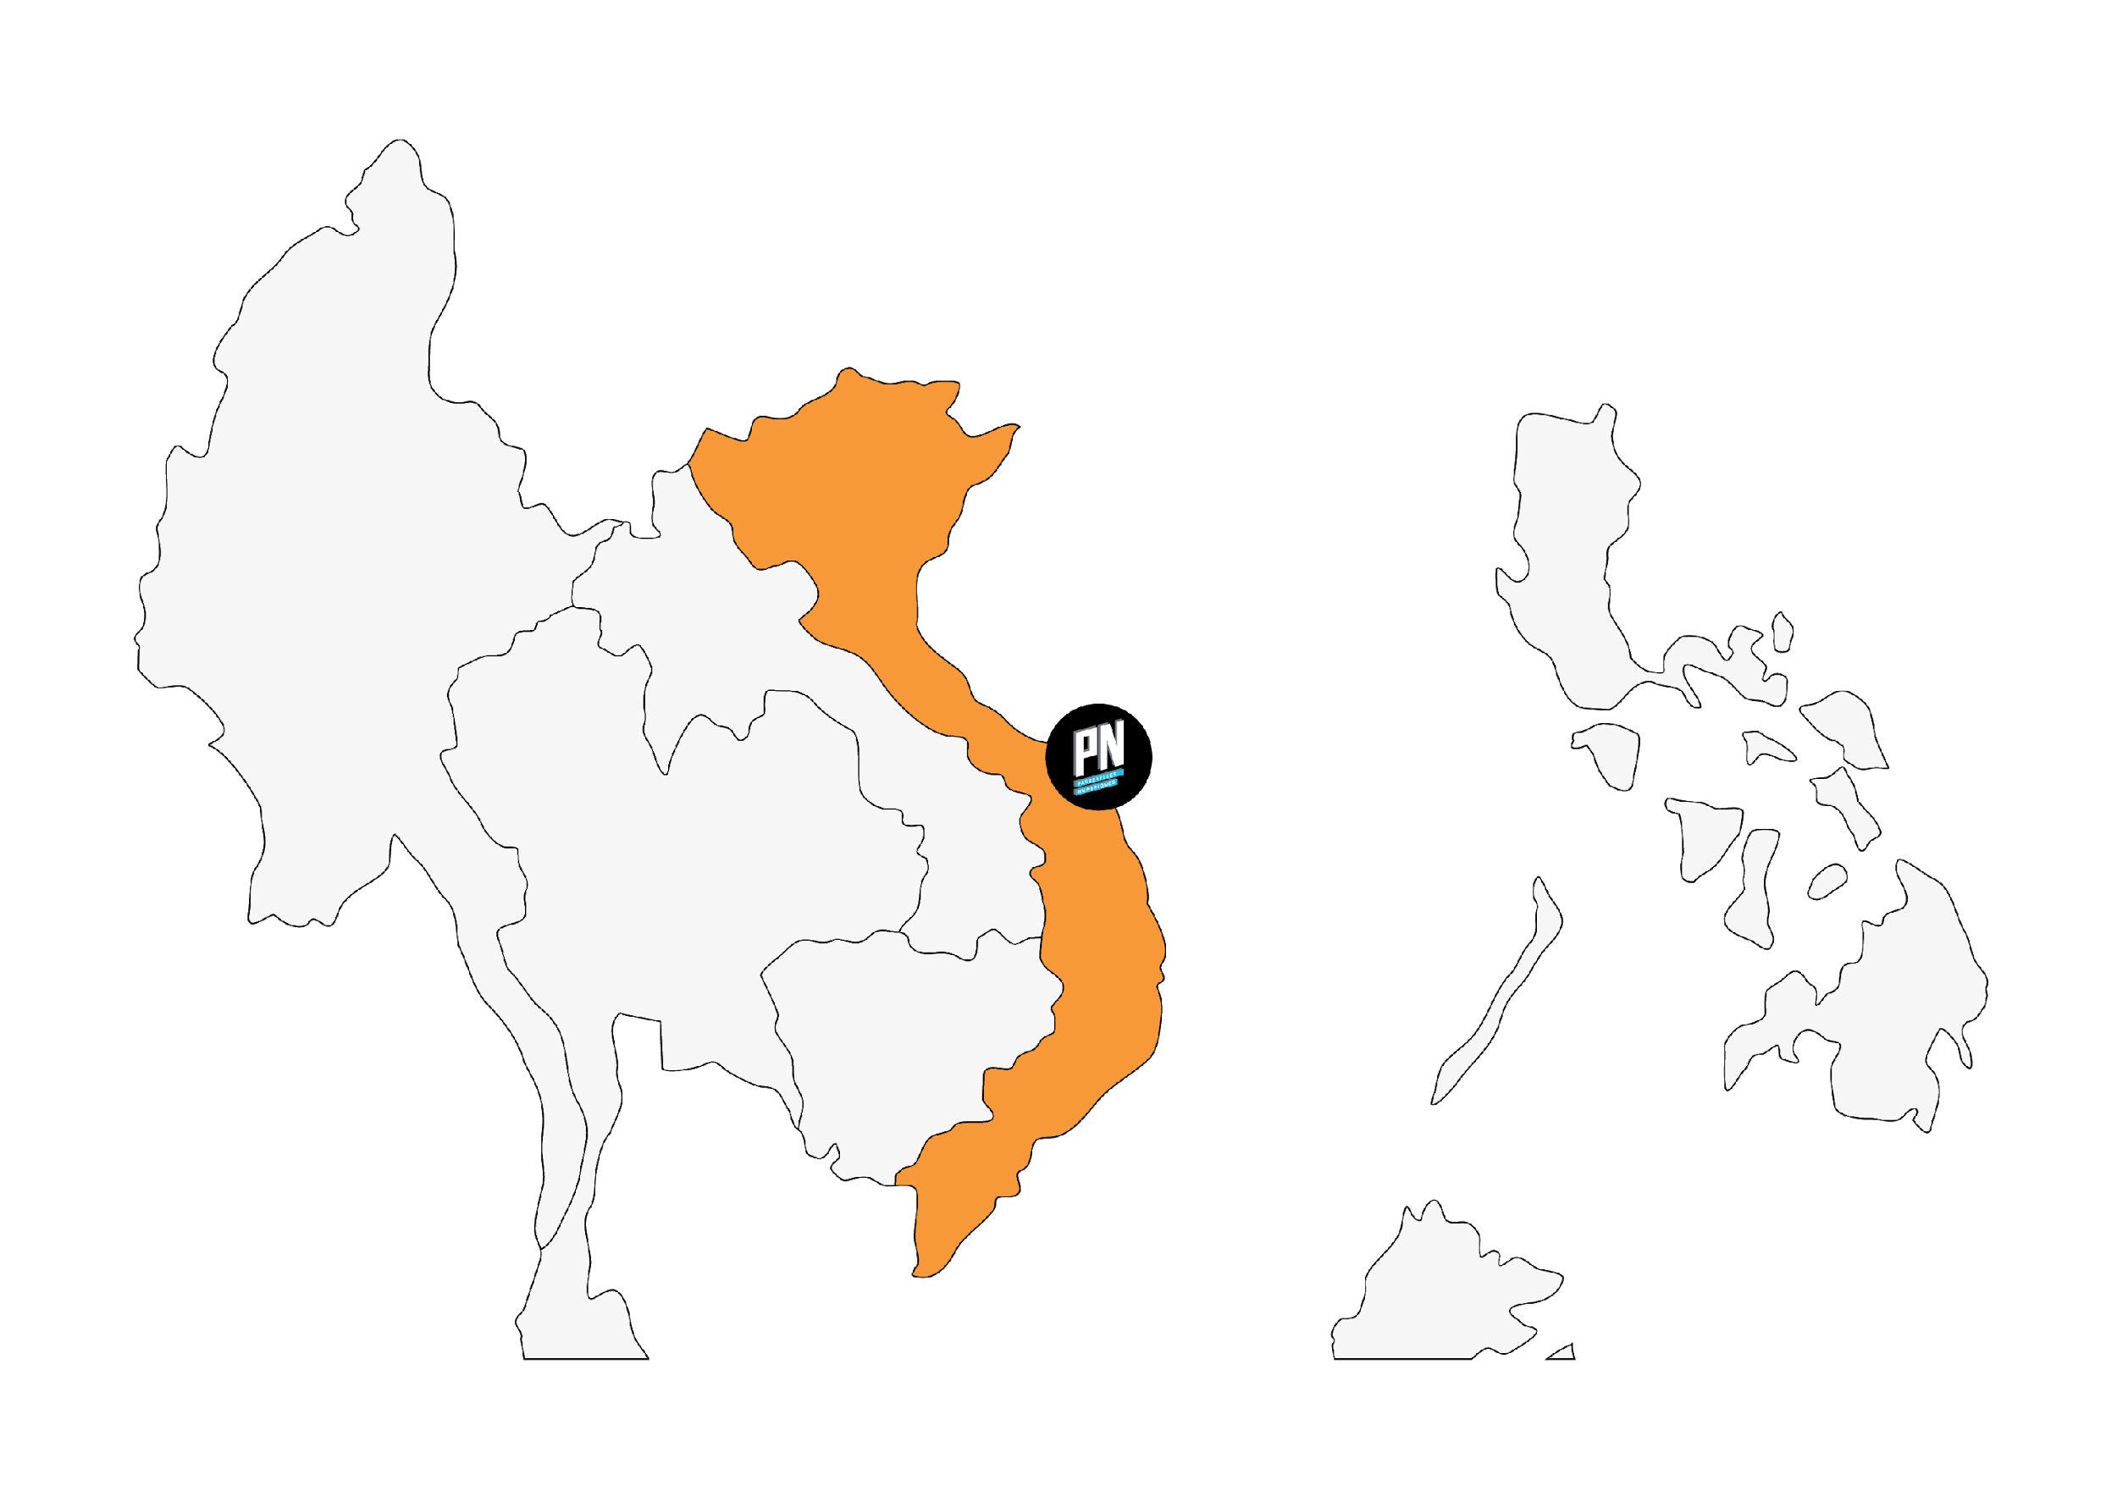



TOOL BOX - 2
Cambodia
Sustainable Development Goals
COUNTRI
ES
Philippines
Vietnam
Singapore
France

